Slide 1
Effective Use of Dilated Convolutions for Segmenting Small Object Instances in Remote Sensing Imagery
Abstract
1.Most of the previous works have not fully taken into account the specific difficulties that exist in remote sensing tasks. One of such difficulties is that objects are small and crowded in remote sensing imagery.
2.we have proposed a novel architecture called local feature extraction (LFE) module attached on top of dilated front-end module.

Slide 2
3.The LFE module is based on our findings that aggressively increasing dilation factors fails to aggregate local features due to sparsity of the kernel, and detrimental to small objects. The proposed LFE module solves this problem by aggregating local features with decreasing dilation factor.
Notes:
Aggregate：聚合，总结
sparsity ：稀疏
detrimental ：有害的

Slide 3
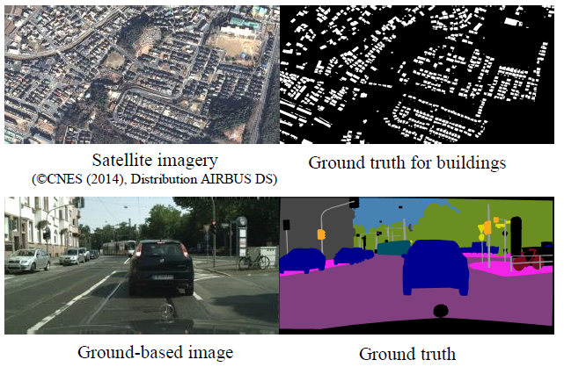
Notes:
the spatial resolution（空间分辨率） of satellite imagery has substantially enhanced.
Accordingly, the size of objects of interest has become smaller.

Slide 4
From the two images we can observe the following differences：
1）Size of objects: compared to the ground-based image, the objects in the satellite imagery are significantly smaller.
2） Layout of objects: in satellite imagery, the objects are densely located. In light of these differences, designing a dedicated architecture is obviously needed for remote-sensing segmentation rather than directly employing modern CNN architectures.

Slide 5
1.To segment such a tight crowd of small objects, one of the most important elements is context in an image.
2.In CNNs, large context is acquired by subsampling layers. Although subsampling layers.
3. Subsampling layers are helpful to expand the receptive field, they ignore the other important element: resolution. Resolution important to resolve a tight crowd of small objects.
Notes:
resolution：分辨率

Slide 6
4. By subsampling layers resolution of features is gradually lost through layers of a network. The resulting coarse features can miss the details of small objects that are difficult to recover even with efforts such as skip connections or hypercolumns. Thus, we need a specific method to expand the receptive field without losing resolutions.
Notes:
skip connections or hypercolumns：其他论文中的一些方法

Slide 7
Introduce of ordinary convolution and dilation convolution:
Notes:
dilation factor
ordinary convolution: dilation=1
The right dilation convolution: dilation=2

Slide 8
The architectural improvements on computer vision community such as the works utilizing FCN, skip connections , encoder-decoder architectures or dilated convolutions.

Slide 9
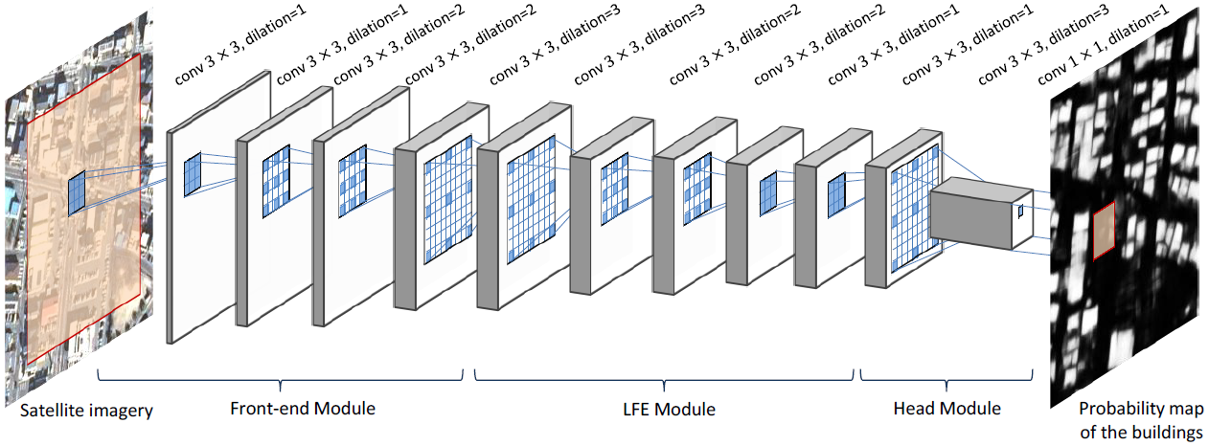

Slide 10
Overview of the Proposed Method
1 Context and resolution are both important.
1) The front-end module is designed to extract features that cover large context, and thus the dilation factors are gradually increased .
2) Conversely, the subsequent LFE module is dedicated to aggregating local features scattered by the front-end module. Thus, the LFE module has the specific structure of decreasing dilation factors .
3) Finally, the head module outputs a probability map with the same resolution as input.

Slide 11
2 Front-end module
In order to satisfy both of a large receptive field and a high spatial resolution, we adopt dilated convolutions .
Specifically, we eliminate all subsampling layers of front-end module and use dilated convolution instead.

Slide 12
3 FLE module
The role of LFE module is to solve problems of front-end module.
Specifically, aggressive application of dilated convolution causes two problems :
1) spatial consistency between neighboring units becomes weak
2) local structure cannot be extracted in higher layer
To handle these two problems, we propose local feature extraction module (LFE) with decreasing dilation factor.
Notes:
spatial :空间的 consistency 一致性

Slide 13
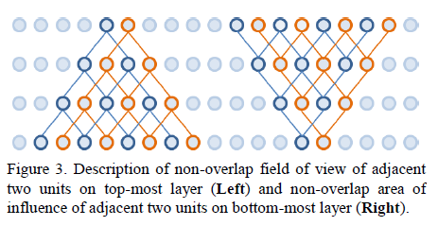
Notes:
每一行都是一层网络
问题1 As long as dilation factor increases, they never overlap again in higher layers
问题2 All units in top most layer receive information from either of the two units, but not both. This means that all units in top most layer are unaware of local structure inside the two units.
With increasing dilation factor, higher layers cannot extract local structure because of non-overlap information pyramid.

Slide 14
4 Post-processing
mask proposals for individual object instances are acquired by simply thresholding the output probability map. Then, for each mask, an object score is computed as a mean of probability values inside the mask
Notes:
Post-processing：后期处理

Slide 15
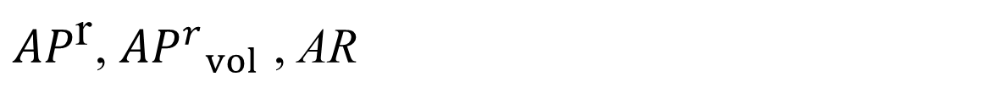
Experiments
Evaluate our method on three datasets
The first one is used to establish and validate our method.
The other two are used to benchmark our method with previously proposed segmentation methods.
Evaluation metric
${AP}^{\text{r}}$, ${{AP}^{r}}_{vol}$ , AR
These metrics are commonly used evaluation metrics for instance-aware semantic segmentation and mask proposal generation task.
Notes:
评估指标来自两篇论文

Slide 16
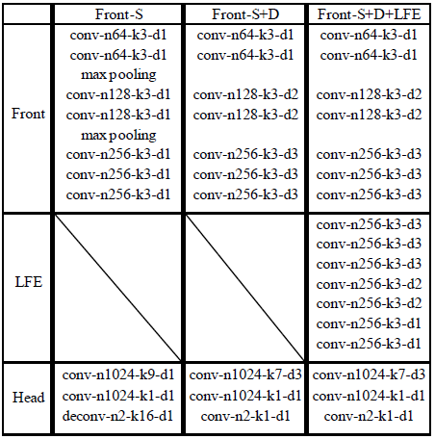
1.In all of the models, convolutional layers except the last one are followed by ReLU activations.
2. The last convolutional layer is followed by softmax layer to output probability map.
Notes:
FOV: 视觉区域
Front-S:普通的网络的，带有池化层，S是指针对小目标， L是指针对大目标→small FOV
Front-S+D: +D是指加上膨胀卷积因子d1、d2、d3
Front-S+D+LFE: 加上特征提取模块

Slide 17
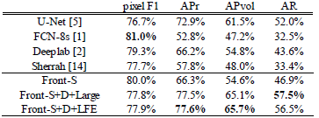

Slide 18
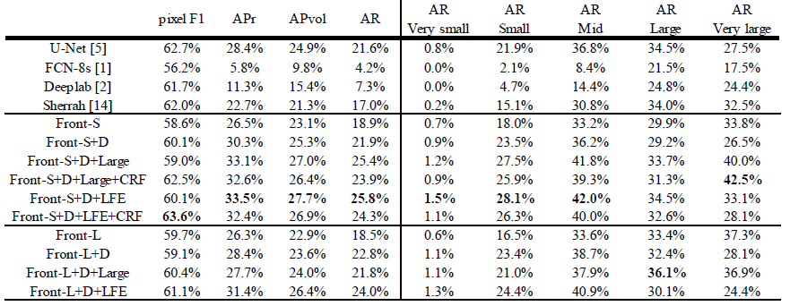

Slide 19
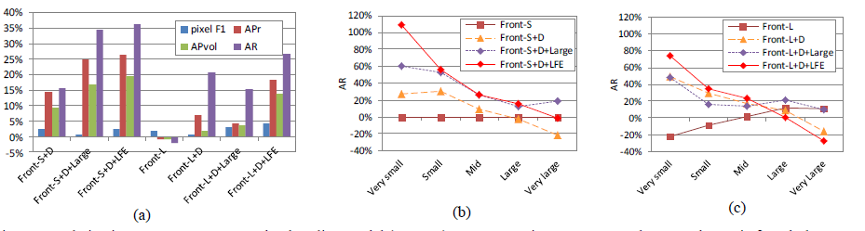

Slide 20
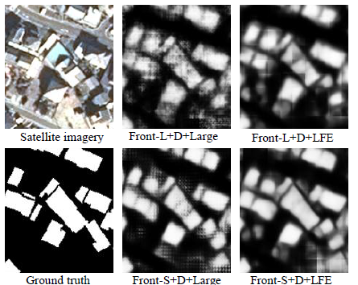

Slide 21
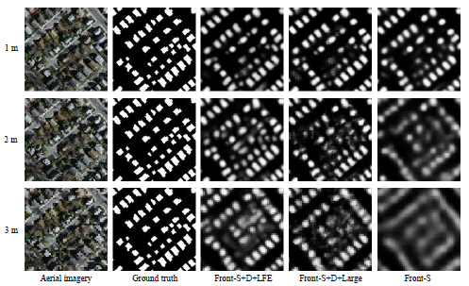
Notes:
针对分辨率来测试的

Slide 22
